Slide 1
Announcements
Mini-Project 1 Due Last night
Mini-Project 2 details tomorrow; 4 weeks (due after midterm);
Work in groups of 2 or 3;
“Modify existing complex codebase to improve some quantifiable metric”
Suggested: Bourbon, but anything “existing complex codebase”
Today:
Unwritten Contract of SSDs (skipping Graph computation on SSDs) - slides
Bourbon: Learned Indexes for LSMs – small groups + all-class polls
Tuesday:
Two papers on Persistent Memory, read both, only need to writeup one (your choice)
Reading Groups: Meet with reading group #2 before Tuesday
Form own reading group (or randomly assign) next

Slide 2

The Unwritten Contract of Solid State Drives
Jun He, Sudarsun Kannan,
Andrea C. Arpaci-Dusseau, Remzi H. Arpaci-Dusseau
Department of Computer Sciences, University of Wisconsin - Madison
Notes:
Good afternoon, I am Jun. I am here to present our work about the unwritten contract of solid state drives.

Slide 3
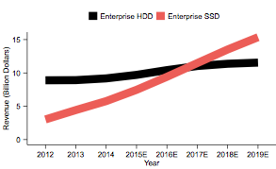
SSDs: Important Storage Media
HDD
2017
SSD
Source: Gartner, Stifel Estimates
https://www.theregister.co.uk/2016/01/07/gartner_enterprise_ssd_hdd_revenue_crossover_in_2017/
Notes:
As you probably has noticed, more and more SSDs are used. This figure shows that enterprise SSD revenue is expected to exceed enterprise HDD this year.

Slide 4

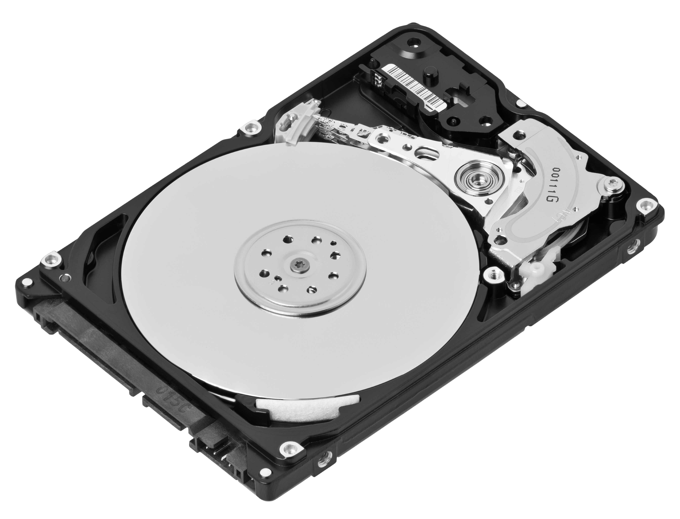
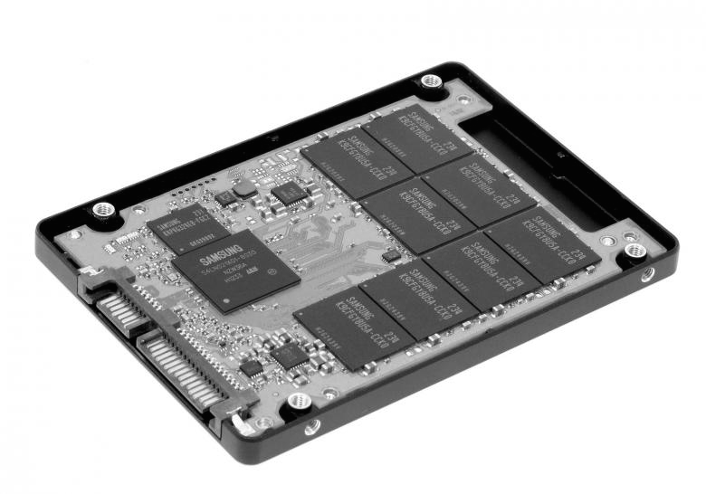
Storage stack is shifting from the HDD era to the SSD era
App
App
for
SSD
?
App
?
FS
FS
FS
for
SSD
?
?
Notes:
As we shift from HDDs to SSDs, most applications and file systems remain the same. One question is whether these old applications and file systems work well. Also, we need to know whether the SSD work well for such old applications and file systems.
As SSDs become popular, there are also applications and file systems optimized for SSDs. We also would like to know whether such new applications and file systems work well on SSDs and whether SSDs work well for them.

Slide 5
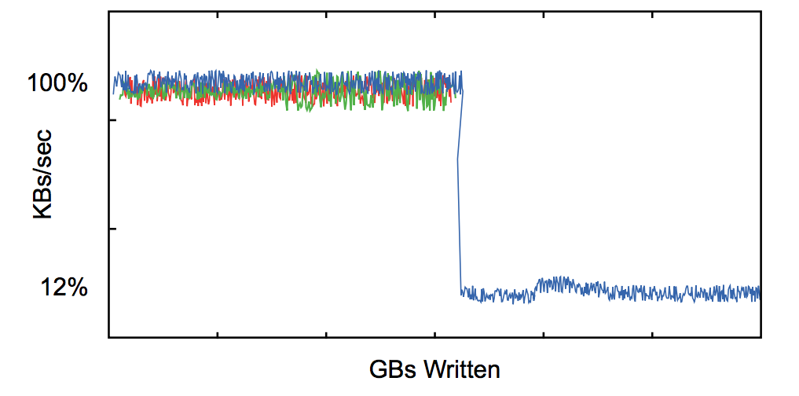
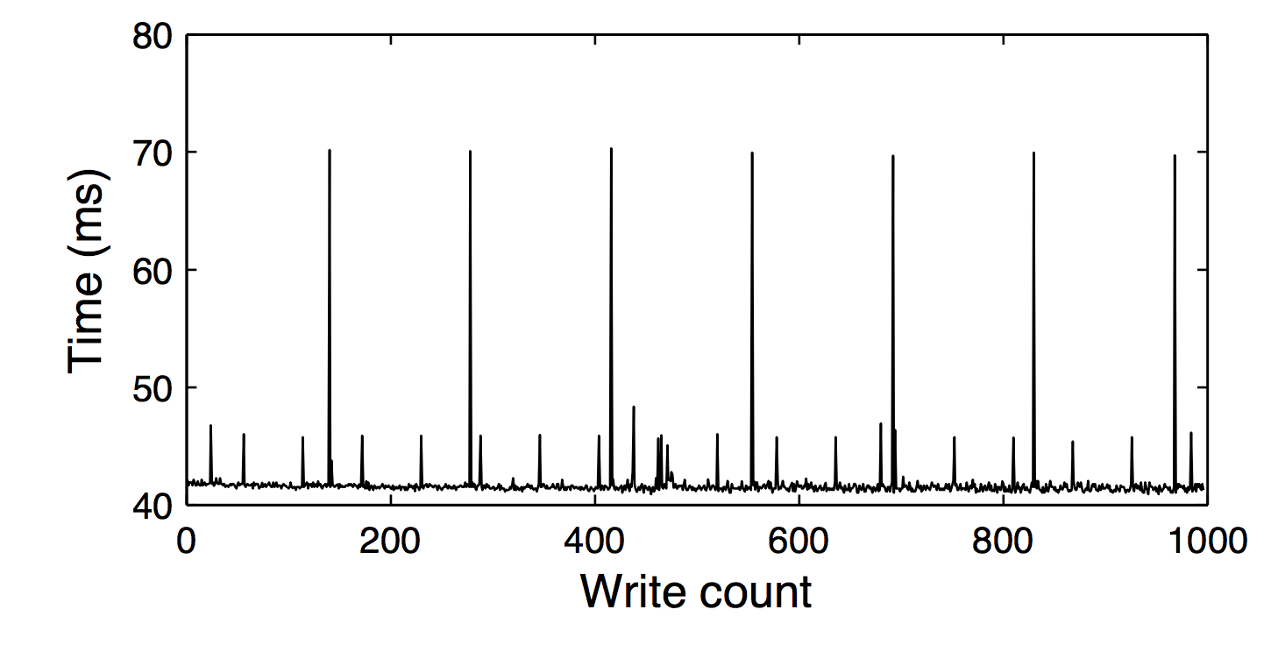

The consequences of misusing SSDs
Performance degradation
Performance fluctuation
Early end of device life
http://crestingwave.com/sites/default/files/collateral/velobit_whitepaper_ssdperformancetips.pdf
S. Boboila and P. Desnoyers. Write Endurance in Flash Drives: Measurements and Analysis. In Proceedings of the 8th USENIX Symposium on File and Storage Technologies (FAST ’10), San Jose, California, February 2010
Notes:
If the applications and file systems do not work well with SSDs, you will have performance degradation, fluctuation. Your device may die sooner.

Slide 6
What is the right way to achieve high performance on SSDs?
Block Device Interface: read(range), write(range), discard(range)
HDD Unwritten Contract
SSD Unwritten Contract
Sequential accesses are best
Nearby accesses are more efficient than farther ones
MEMS-based storage devices and standard disk interfaces: A square peg in a round hole?
Steven W. Schlosser, Gregory R. Ganger
FAST’04
Request Scale
Locality
Aligned Sequentiality
Grouping by Death Time
Uniform Data Lifetime
Notes:
We know that misuses of SSD could cause problems. But what’s the right way to achieve high performance on SSDs?
Block devices provide a uniform interface. You can read, write, or discard a range. But different ways of using the interface can have very different performance. Schlosser and Ganger have studied the unwritten contract of HDD, which specifies the right way to use HDD. But, what’s the unwritten contract of SSDs?
In this paper, we have summarized five rules of the unwritten contract from existing studies and our experience of implementing an SSD simulator. Users of SSD could follow these rules to get high performance. Later, we will introduce these rules one by one.

Slide 7
SSD Background
Controller
RAM
FTL
address mapping
garbage collection
wear-leveling
Mapping Table
Data Cache
Channel
Channel
Channel
Block
Block
Block
P
P
P
P
P
P
P
P
P
P
P
P
P
P
P
P
P
P
P
P
P
P
P
P
P
P
P
…
…
…
…
…
…
…
…
…
…
…
…
…
Notes:
Before introducing the rules, let’s look at some background of SSD. There are pages inside an SSD. Each page is, for example, 4KB. Multiple pages form a block. A block is usually 2MB. Because of the property of flash, you can only overwrite a page after erasing the whole block.
Multiple blocks form a channel. There can be multiple channels. Channels can work independently. Channels are connected with a bus. The bus is connected to a controller. In the controller, there is a very important piece of software, called FTL. FTL manages address mapping, garbage collection and wear-leveling. The controller is connected to some RAM. The RAM stores mapping table and data cache.

Slide 8
NAND Flash
Hold charge in cells. No moving parts!
Inherently parallel.
No seeks!

Slide 9
SLC: Single-Level Cell
1
0
charge
charge
NAND Cell
NAND Cell

Slide 10
MLC: Multi-Level Cell
00
01
charge
charge
NAND Cell
NAND Cell
10
11
charge
charge
NAND Cell
NAND Cell

Slide 11
Single- vs. Multi- Level Cell
SLC
MLC
charge
charge
expensive
robust
cheap
sensitive
Problem: flash cells wear out after being overwritten too many times.
SLC: ~100K times
MLC: ~10K times
Wear leveling - prevents some cells from wearing out while others still fresh

Slide 12
Parallelism
Flash devices are divided into banks (aka, planes or channels)
Banks can be accessed in parallel
read
read
Bank 0
Bank 1
Bank 2
Bank 3

Slide 13
Flash Writes
Writing 1’s:
- slow, course-grained [blocks(2MB)]
- called “erase”
Writing 0’s:
- fast, fine-grained [pages (4KB)]
- called “program”

Slide 14
Disk vs. Flash Performance
Throughput:
- disk: ~130 MB/s (best case sequential)
- flash: ~200 MB/s
Latency:
- disk: ~5 ms (one op)
- flash
- read: 10-50 us
- erase: 2 ms
- program: 200-500 us

Slide 15
Flash Translation Layer
write 1101
free
valid
logical:
program
0
1
2
3
4
5
6
7
erase
relocate
or TRIM
0001
0010
00
11
0000
10
01
11
01
physical:
11
11
11
11
11
11
invalid
block 0
block 1
must eventually
be garbage collected
Physical pages can be in three states: valid, invalid, free

Slide 16
Problem: Big Mapping Table
Assume 200GB device, 2KB pages, 4-byte entries
RAM needed for page-level mappings: (200GB / 2KB) * 4 bytes = 400 MB
Too big, RAM is expensive!
Two solutions:
Put portion of Mapping Table in FLASH, Cache recently-accessed in SSD RAM
Hybrid-Mapping FTL (some block mappings, some page mappings)

Slide 17
Rules of the Unwritten Contract
#1 Request Scale
#2 Locality
#3 Aligned Sequentiality
#4 Grouping by Death Time
#5 Uniform Data Lifetime
Notes:
Now let’s look at the rules one by one.

Slide 18
Rule #1: Request Scale
SSD clients should issue large data requests or multiple outstanding data requests.
Request
SSD
High internal parallelism
Channel
Channel
Channel
Channel
Notes:
Rule number one simply says that SSD clients should issue large data requests. The contract has this rule because there are multiple channels in the SSD and we need to utilize all of them for high performance. For example, if we comply with this rule and send large request to the SSD. The SSD can stripe the request and distribute the requests to all channels. In this way, we can get high internal parallelism.

Slide 19
Rule #1: Request Scale Violation
If you violate the rule:
- Low internal parallelism
Request
SSD
Channel
Channel
Channel
Channel
Performance impact:
18x read bandwidth
10x write bandwidth
F. Chen, R. Lee, and X. Zhang. Essential Roles of Exploit- ing Internal Parallelism of Flash Memory Based Solid State Drives in High-speed Data Processing. In Proceedings of the 17th International Symposium on High Performance Com- puter Architecture (HPCA-11), pages 266–277, San Antonio, Texas, February 2011.
Wasted
Notes:
If we violate this rule, and send small request to SSD, in this example, only one channel is used and the rest is wasted.
So, if you violate this rule, you will end up with low internal parallelism. According to existing studies, violation can reduce read bandwidth by 18 times and write bandwidth by 10 times.

Slide 20
Rule 2: Locality
SSD clients should access with locality
SSD
RAM
Hit
Translation Cache
High Cache Hit Ratio
Logical
to Physical
Mapping
Table
P
P
P
P
P
P
P
P
P
P
P
P
P
P
P
P
P
P
P
P
FLASH
P
P
P
P
P
P
Notes:
In page-level mapping, you have large mapping table stored in flash, the mapping entries are loaded to memory when they are needed. If you have good locality, the same entries can be reused for many times.

Slide 21
Rule 2: Locality Violation
SSD clients should access with locality
SSD
If you violate the rule:
Translation cache misses
More translation entry reads/writes
RAM
P
P
P
P
P
P
P
P
Logical
to Physical
Mapping
Table
P
P
Performance impact:
2.2x average response time
Y. Zhou, F. Wu, P. Huang, X. He, C. Xie, and J. Zhou. An Efficient Page-level FTL to Optimize Address Translation in Flash Memory. In Proceedings of the EuroSys Conference (EuroSys ’15), Bordeaux, France, April 2015.
P
P
P
P
P
P
P
P
P
P
P
P
P
P
P
P
P
P
P
P
P
P
P
P
P
P
P
P
P
P
P
P
FLASH

Slide 22
Rule 3: Aligned Sequentiality
For hybrid mapping FTL: compromise between page and block-level mappings
Notes:
In hybrid FTLs, you have both page-level mapping and block-level mapping. Page-level mapping is flexible but it takes more space. Block-level mapping is less flexible but takes much less space. When we are about to run out of memory, we want to convert page-level mapping to block-level mapping. For example, we have logical block 2 and physical block 4. If you comply with the rule, you will have nice mapping, …

Slide 23
Per-Page Translations
logical:
0
1
2
3
4
5
6
7
physical:
0001
0010
00
11
0000
10
01
0101
11
11
11
11
block 0
block 1

Slide 24
2-Page Translations
logical:
0
1
2
3
4
5
6
7
physical:
0001
0010
00
11
0000
10
01
0101
11
11
11
11
block 0
block 1
Disadvantages?
- more read-modify-write updates
- more garbage
- less flexibility for placement
Advantage: Reduce number of translations!

Slide 25
2-Page Translations
write 1011
logical:
0
1
2
3
4
5
6
7
physical:
0001
0010
00
11
0000
10
01
0101
11
11
11
11
block 0
block 1
Disadvantages?
- more read-modify-write updates
- more garbage
- less flexibility for placement

Slide 26
2-Page Translations
write 1011
logical:
0
1
2
3
4
5
6
7
copy
physical:
0001
0010
00
11
0000
10
01
0101
10
11
0101
block 0
block 1
Disadvantages?
- more read-modify-write updates
- more garbage
- less flexibility for placement

Slide 27
2-Page Translations
write 1011
logical:
0
1
2
3
4
5
6
7
physical:
0001
0010
00
11
0000
10
01
0101
10
11
0101
block 0
block 1
Disadvantages?
- more read-modify-write updates
- more garbage
- less flexibility for placement

Slide 28
Hybrid FTL
Use course-grained mapping for most (e.g., 95%) of data Map at block level
Use fine-grained mapping for recent (changing) data Map at page level
Write changed pages to designated log blocks.
After log blocks become full, merge changes with old data
full merge
partial merge
switch merge
Eventually garbage collect old pages

Slide 29
Full Merge
write D2
logical:
…
0
1
2
3
physical:
A
B
C
D
1111
1111
11
11
11
11
1111
1111
11
11
11
11
D2
block 0
block 1 (log)
block 2
eventually, need to get rid of page mappings because they are expensive

Slide 30
Full Merge
logical:
…
0
1
2
3
physical:
A
B
C
D
D2
1111
11
11
11
11
A
B
C
D2
block 0
block 1 (log)
block 2

Slide 31
Full Merge
logical:
…
0
1
2
3
garbage
physical:
A
B
C
D
D2
1111
11
11
11
11
A
B
C
D2
block 0
block 1 (log)
block 2

Slide 32
Merging
Three merge types:
- full merge
- partial merge
- switch merge

Slide 33
Partial Merge
logical:
…
0
1
2
3
physical:
A
B
C
D
1111
1111
11
11
11
11
1111
1111
11
11
11
11
block 0
block 1 (log)
block 2

Slide 34
Partial Merge
write D2
logical:
…
0
1
2
3
physical:
A
B
C
D
1111
1111
11
11
11
11
1111
1111
11
11
11
11
block 0
block 1 (log)
block 2

Slide 35
Partial Merge
write D2
logical:
…
0
1
2
3
physical:
A
B
C
D
1111
1111
11
11
D2
1111
1111
11
11
11
11
block 0
block 1 (log)
block 2

Slide 36
Partial Merge
logical:
…
0
1
2
3
physical:
A
B
C
D
1111
1111
11
11
D2
1111
1111
11
11
11
11
block 0
block 1 (log)
block 2

Slide 37
Partial Merge
logical:
…
0
1
2
3
physical:
A
B
C
D
A
B
C
D2
1111
1111
11
11
11
11
block 0
block 1 (log)
block 2

Slide 38
Partial Merge
logical:
…
0
1
2
3
physical:
A
B
C
D
A
B
C
D2
1111
1111
11
11
11
11
block 0
block 1 (log)
block 2

Slide 39
Partial Merge
logical:
…
0
1
2
3
physical:
A
B
C
D
A
B
C
D2
1111
1111
11
11
11
11
block 0
block 1
block 2

Slide 40
Partial Merge
logical:
…
0
1
2
3
garbage
physical:
A
B
C
D
A
B
C
D2
1111
1111
11
11
11
11
block 0
block 1
block 2

Slide 41
Merging
Three merge types:
- full merge
- partial merge
- switch merge

Slide 42
Switch Merge
logical:
…
0
1
2
3
physical:
A
B
C
D
1111
1111
11
11
11
11
1111
1111
11
11
11
11
block 0
block 1 (log)
block 2

Slide 43
Switch Merge
write A2
logical:
…
0
1
2
3
physical:
A
B
C
D
1111
1111
11
11
11
11
1111
1111
11
11
11
11
block 0
block 1 (log)
block 2

Slide 44
Switch Merge
write A2
logical:
…
0
1
2
3
physical:
A
B
C
D
A2
1111
11
11
1111
1111
1111
11
11
11
11
block 0
block 1 (log)
block 2

Slide 45
Switch Merge
write B2
logical:
…
0
1
2
3
physical:
A
B
C
D
A2
B2
11
11
1111
1111
1111
11
11
11
11
block 0
block 1 (log)
block 2

Slide 46
Switch Merge
write C2
logical:
…
0
1
2
3
physical:
A
B
C
D
A2
B2
C2
1111
1111
1111
11
11
11
11
block 0
block 1 (log)
block 2

Slide 47
Switch Merge
write D2
logical:
…
0
1
2
3
physical:
A
B
C
D
A2
B2
C2
D2
1111
1111
11
11
11
11
block 0
block 1 (log)
block 2

Slide 48
Switch Merge
logical:
…
0
1
2
3
garbage
physical:
A
B
C
D
A2
B2
C2
D2
1111
1111
11
11
11
11
block 0
block 1 (log)
block 2

Slide 49
Rule 3: Aligned Sequentiality
For hybrid mapping FTL: compromise between page and block-level mappings
Notes:
In hybrid FTLs, you have both page-level mapping and block-level mapping. Page-level mapping is flexible but it takes more space. Block-level mapping is less flexible but takes much less space. When we are about to run out of memory, we want to convert page-level mapping to block-level mapping. For example, we have logical block 2 and physical block 4. If you comply with the rule, you will have nice mapping, …

Slide 50
Rule 4: Grouping By Death Time
Data with similar death times should be placed in the same block.
1pm
2pm
1pm
2pm
1pm
2pm
1pm
2pm
Notes:
Rule 4 says that data with similar death time should be placed in the same block. For example, if

Slide 51
Rule 4: Grouping By Death Time
Data with similar death times should be placed in the same block.
1pm
1pm
2pm
1pm
1pm
2pm
1pm
1pm
2pm
Time
1pm
2pm
1pm
1pm
2pm
😀
Notes:
Rule 4 says that data with similar death time should be placed in the same block. For example, if

Slide 52
Rule 4: Grouping By Death Time Violation
1pm
1pm
1pm
1pm
1pm
1pm
1pm
1pm
2pm
2pm
2pm
2pm
Time
1pm
2pm
2pm
2pm
2pm
2pm

Slide 53
Rule 4: Grouping By Death Time Violation
If you violate the rule:
Performance penalty
Write amplification
Data movement!!!
1pm
1pm
1pm
1pm
1pm
1pm
Performance impact:
4.8x write bandwidth
1.6x throughput
1.8x block erasure count
C. Lee, D. Sim, J.-Y. Hwang, and S. Cho. F2FS: A New File System for Flash Storage. In Proceedings of the 13th USENIX Conference on File and Storage Technologies (FAST ’15), Santa Clara, California, February 2015.
J.-U. Kang, J. Hyun, H. Maeng, and S. Cho. The Multi- streamed Solid-State Drive. In 6th USENIX Workshop on Hot Topics in Storage and File Systems (HotStorage ’14), Philadelphia, PA, June 2014.
. Y. Cheng, F. Douglis, P. Shilane, G. Wallace, P. Desnoyers, and K. Li. Erasing Belady’s Limitations: In Search of Flash Cache Offline Optimality. In 2016 USENIX Annual Technical Conference (USENIX ATC 16), pages 379–392, Denver, CO, 2016. USENIX Association.
2pm
2pm
2pm
2pm
Time
1pm
2pm
2pm
2pm
2pm
2pm
😞

Slide 54

Rule 5: Uniform Data Lifetime
Clients of SSDs should create data with similar lifetimes
Lifetime
1 Day
Notes:
To avoid uneven flash wear-out, rule 5 says that clients of SSDs should create data with similar lifetimes. For example, if all you data has lifetime of one day, the blocks of this SSD will be evenly programmed and erased. No wear-leveling is needed.
If you violate this rule and have data with lifetimes of one day and one thousand years, the blocks occupied by long-living data will be used much less than the rest of the blocks. Wear-leveling is needed to balance the usage in this case.
Violation of this rule will lead to performance penalty and write amplification. According to existing studies, the performance penalty is large.

Slide 55
Rule 5: Uniform Data Lifetime
Clients of SSDs should create data with similar lifetimes
Lifetime
1 Day
No wear-leveling needed
SSD
3
3
3
3
0
1
2
0
1
0
2
0
1
1
2
Usage Count:
2

Slide 56

Rule 5: Uniform Data Lifetime Violation
If you violate the rule:
Performance penalty
Write amplification
Lifetime
1 Day
Some blocks wear out sooner
Frequent wear-leveling needed!!!
1000 Years
Performance impact:
1.6x write latency
S. Boboila and P. Desnoyers. Write Endurance in Flash Drives: Measurements and Analysis. In Proceedings of the 8th USENIX Symposium on File and Storage Technologies (FAST ’10), San Jose, California, February 2010.
SSD
0
1
2
3
0
1
0
1
2
3
0
365*1000
365*1000
1
Usage Count:

Slide 57
Conclusions
Understanding the unwritten contract is crucial for designing high performance application and file systems
System designing demands more vertical analysis
#1 Request Scale
#2 Locality
#3 Aligned Sequentiality
#4 Grouping by Death Time
#5 Uniform Data Lifetime
Notes:
To conclude, in this paper, we reveal the five …

Slide 58
Learned Indexes for SSD-Optimized LSMs
Yifan Dai, Yien Xu, Aishwarya Ganesan, Ramnatthan Alagappan, Brian Kroth, Andrea Arpaci-Dusseau, and Remzi Arpaci-Dusseau.
From WiscKey to Bourbon: A Learned Index for Log-Structured Merge Trees.
In 14th USENIX Symposium on Operating Systems Design and Implementation (OSDI’20), October 2020.
Small-groups
List of 12 questions to cover; find list in Canvas
Will be poll questions when you return to whole class
Go over answers

Slide 59
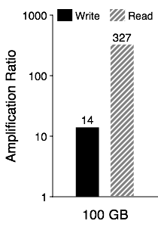
I/O Amplification in LSM-trees
Random load:
a 100GB database
Random lookup:
100,000 lookups
Problems:
large write amplification
large read amplification
Notes:
However, i/o amplification is a major problem in lsm-trees.
i/o amplification is defined as the ratio between the amount of data issue to the device and
the amount of data requested by the user.
let’s look at i/o amplification of leveldb with a simple experiment.
to analyze the write amplification, we randomly load a 100GB database, and measure the amount of
data written to the device. We found that leveldb wrote 14x times data to the device.
The main reason is the background compaction, constantly sorting data in the background.
Kv pairs are read, sort, and write back over and over again.
to analyze the read amplification, we issue 100,000 random lookup to the 100 gb database.
we found the read amplification can be over 300. the main reason is that to lookup a kv pair,
leveldb may need to search multiple files at at different levels. for each file, it needs to read
extra metadata to search the kv pair.
So, lsm-trees have large write amplification and read amplification.

Slide 60
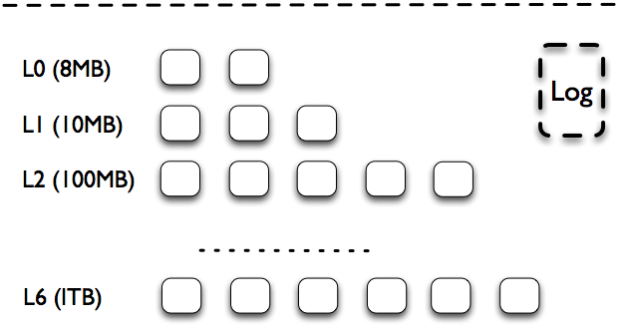
LSM-trees: Insertion
1. Write sequentially 2. Sort data for quick lookups
3. Sorting and garbage collection are coupled
3
2
memT
memT
KV
memory
1
disk
4
5
LevelDB
Notes:
since lsm-trees are so popular, now, let’s look at a Google’s implementation leveldb briefly,
understand its high-level architecture.
as shown in this picture, on-disk: there are one log file and many table files.
Key-value pairs are inserted to the log file first in case of a crash.
A table file contains sorted kv pairs. Table files are logically partitioned into seven levels.
The size of all files in each level is limited, increase by a factor of 10 across levels.
For example, the size limit of all files at L1 is10MB/ L2: 100MB
go through the insertion process. a background thread flush mem to be a table file on L0 on disk.
Once the size of a level exceeds its limit, a background thread will pick one file, and merge sort with
files on the next level. This is called compaction. So, compaction involves reading several files, do sorting in memory, and write the back to disk again.
in summary:

Slide 61
LSM-trees: Lookup
Random reads
Travel many levels for a large LSM-tree
1
memT
K
memory
2
3 L1 to L6
disk
LevelDB
Notes:
meltable:
l0: files have key ranges overlapped, lookup all files in this level
L1 to L6: one file at each level, key ranges of different files do not overlap

Slide 62
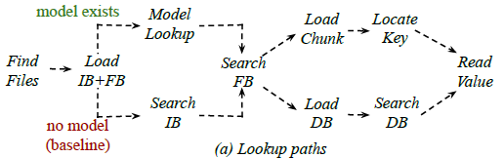
Full Lookup Path
Notes:
To sum up, this is the full lookup path of Sazerac. When we reach a file, we check if there exists a model for this file. If so, we do a model lookup, check the filter and then search in the target chunk. If not, we go through the baseline Index Block, Filter Block and Data Block way. At the end, we use the value address to read the actual vale in the value log.

Slide 63
Wisckey in Get Workload
key
value
k, addr
value
LSM-tree
Value Log
Notes:
Wisckey does one major change in the LevelDB structure. Instead of storing the whole key-value pairs, Wisckey stores key-value_address pairs in the previous LSM-tree structure and store values in a separate value log. During gets, after a search in the LSM-tree, Wisckey requires another lookup in the value log to retrieve the actual value, but this extra random access is not expensive with an SSD, which Wisckey is designed for. For large values, Wisckey has huge gain in terms of puts and compactions and leaves a much smaller LSM-tree, which also benefits the get workload. Also, Wisckey gives us a constant value size, the pointer size, that largely accelerates and simplifies our design.

Slide 64
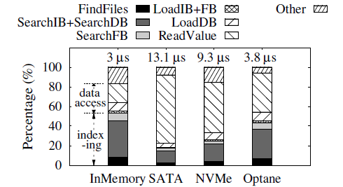
Beneficial Regime
Read-only experiments on Wisckey when data resides on memory and different storage devices.
Notes:
We do a set of read-only experiments on Wisckey, the baseline, when the data resides on different devices, and measure the percentage of time spent in different operations during a lookup. The Indexing parts we can improve include FindFiles and searching IB and DB.
On the graph below, we show the percentages of each step of the lookup process when the data resides on different devices. From the graph, we can see that the indexing part takes half of the total time when the data is in memory, but only about 20 percent when data is on a SATA SSD device.
However, when the storage devices go faster, the portion of indexing becomes larger again. Given the trend that emerging storage devices get faster, Sazerac will be even more beneficial.
In the following experiments except for the last one, we all use 16 byte keys, 64 byte values and the data reside in memory. If not specifically mentioned, the workload is in uniform random distribution.

Slide 65
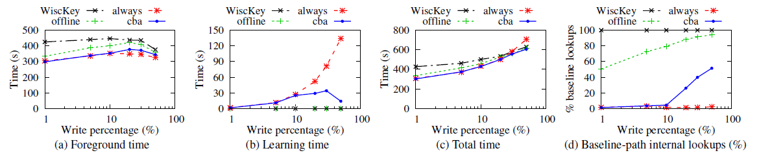
Read-Write mix workload
Study the effectiveness of CBA on uniformly random workloads on AR dataset with write percentage from 0.1%-50%.
Notes:
Then we study the read-write mix workload and the effectiveness of our cost-benefit analyzer. We run uniform random workloads on AR dataset with write percentages from 0.1%-50%.
In these graphs, the black line is baseline Wisckey. The red line is a policy that always learns a new file when it is generated. The green line is a policy that only use existing models and does not learn any new files. The blue line is a policy with our cost-benefit analyzer.
The first graph is the foreground time of different learning policies. The second graph is the learning time. The third graph is the total time, which is the sum of foreground time, learning time and an un-shown compaction time. The introduction of learning doesn’t affect compaction much. The last graph is the percentage of lookups that follows the baseline path.
Graph b, learning time, is a direct representation of how much learning is done. We can see that when the write rate is low, our cost benefit analyzer judges that all the new files are worthwhile to learn and learns as much as the always learn policy does.
When the write rate increases, the number of newly generated files increases so the red line goes high, but our analyzer decides that only a portion of them should be learned so the amount of learning is controlled.
However, as we can see in graph a, the reduced amount of learning doesn’t affect foreground latency much, and the total time is largely reduced, as shown in graph c. One reason is that we always choose to learn the files that our collected data suggest will serve a large amount of lookups. This is shown in graph d, where in the right most data point, though we learn only a small number of files compared to the always-learn policy, about half of the lookups go through the models.

Slide 66
Outline
Overview
SSD Unwritten Contract
Violations of the Unwritten Contract
Conclusions
Notes:
We have just finished the overview of the talk.
We will introduce the rules of SSD unwritten contract and

Slide 67
Do applications/file systems comply with the unwritten contract?
Notes:
Now we have introduced all the five rules, let’s check whether the applications and file systems comply with the rules.

Slide 68
Do the current apps/FSes comply with the unwritten contract of SSDs?
for
SSD
SQLite
(RollBack)
SQLite
(WAL)
5 apps
LevelDB
RocksDB
Varmail
for
SSD
3 file systems
ext4
F2FS
XFS
Contract
Rule 1
Rule 2
Rule 3
Rule 4
Rule 5
Notes:
Now we know that SSDs have an unwritten contract. The next question is “Do the current applications and file systems comply with the unwritten contract?”
To answer this question, we run combinations of applications and file systems, and check whether they comply with each of the rules of the unwritten contract. For example, we ran SQLite on top of F2FS and check whether they comply with rule No. 4.

Slide 69
We conduct vertical analysis to find violations of SSD contract.
App
+
Root Cause
FS
Block Trace
Analyzer:
WiscSee
SSD
Rule violation?
SSD Simulator: WiscSim
Notes:
To find out the violations of the SSD unwritten contract, we run an application and a file system on top of a real SSD. We collect the trace and feed the trace to a SSD simulator that we developed. Then we analyze the block trace and the internal states of the SSD simulator to find out if there is any violation. At the end, we will go back to the applications and file systems to find out the root causes of the violations.

Slide 70
24 Observations
Notes:
Now we have introduced all the five rules, let’s check whether the applications and file systems comply with the rules.

Slide 71
LevelDB & RocksDB read and write large files
Mem Table
KV
Memory
Drive
File
File
Compact
File
File
File
Files: ~2MB each
Request scale is supposed to be large.
File
File
File
File
File
Notes:
Before explaining the small size and concurrency of requests, let’s see how LevelDB and RocksDB work. LevelDB and RocksDB are key-value stores. The key-value pairs are buffered in the memory and flushed to the drive in large sizes. The compaction also read and write large files. The files are about 2MB each. Request scale is supposed to be large.

Slide 72
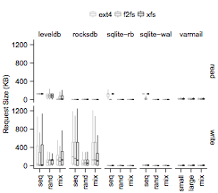
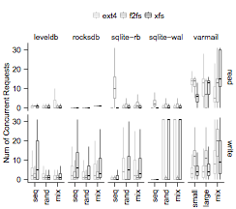
We evaluate request scale by request size and number of concurrent requests
Notes:
We evaluate request scale by request size and the number of concurrent requests. These two figures show the results of all the applications and file systems. Now let’s focus on these two parts. They show the results of insertions and background compactions of LevelDB and RocksDB. The median of the request sizes is only 100 KB. The median of the number of concurrent requests is only 2.

Slide 73
Request Scale
Observation 1 (App): Log structure increases the scale of write size of applications, as expected
Observation 2 (App): The scale of read requests is often low.
Observation 3 (App): SSD-conscious optimizations have room for improvements
Observation 7 (FS): FS log structuring fragments application data structures

Slide 74
We evaluate request scale by request size and number of concurrent requests
3
2
7
7
1
Notes:
We evaluate request scale by request size and the number of concurrent requests. These two figures show the results of all the applications and file systems. Now let’s focus on these two parts. They show the results of insertions and background compactions of LevelDB and RocksDB. The median of the request sizes is only 100 KB. The median of the number of concurrent requests is only 2.

Slide 75
Request Scale
Observation 5 (FS): Linux buffer I/O limitation (page cache) limits request scale

Slide 76
Buffered read(): Page cache implementation splits and serializes user requests
App
read()
2MB
Page Cache
128KB
128KB
128KB
…
Surprise! Even reading 2MB in your app will not utilize SSD well.
Block Layer
SSD
128KB
128KB
128KB
Notes:
One reason for the low request scale is that page cache implementation splits and serialize user requests.
Both LevelDB and RocksDB use buffered read. When you read 2MB of data, page cache will issue a 128KB request to SSD one at a time. 128KB is the readahead size of the OS. Such design works OK for spinning disk because spinning disk is slow and can only process one request at a time. But 128KB request at a time is too small for SSD. Because of this, reading 2MB in your application will not utilize the SSD well.

Slide 77
Cause of Violation
Large reads are throttled by small prefetching (readahead).

Slide 78
Locality Observations
Observation 11(FS): Legacy policies could break locality
Observation 12 (FS): Log structuring is not always log-structured

Slide 79
FTL Miss Curves
11
Miss rate
12

Slide 80
Aligned Sequentiality
Observation 15 (FS): Log-structured file systems may not be as sequential as commonly expected - again!
App performs small overwrite, which triggers in-place updates

Slide 81
Unaligned Ratios
15

Slide 82
Death Time: Zombie Curves

Slide 83
Lifetime

Slide 84
Lessons Learned
The SSD contract is multi-dimensional
Optimizing for one dimension is not enough
We need more sophisticated tools to analyze workloads
Although not perfect, traditional file systems perform surprisingly well upon SSDs
Myths spread if the unwritten contract is not clarified
“Random writes increase GC overhead”
Notes:
We have learned several lessons from this study. First, the SSD contract is mutli-dimensional. So optimizing one dimension is not enough. Because it is complicated, we need more sophisticated tools to analyze the workloads.
We also learned that although not performance, traditional file systems, such as ext4 and XFS, perform well upon SSDs, mostly because HDDs share some contract rules with SSDs.
We also learned that myths spread if the unwritten contract is not clarified. For example, it is often believed that random writes increase GC overhead. Our study shows that they are irrelevant.

Slide 85
Conclusions
Understanding the unwritten contract is crucial for designing high performance application and file systems
System designing demands more vertical analysis
WiscSee (analyzer) and WiscSim (SSD simulator) are available at:
http://research.cs.wisc.edu/adsl/Software/wiscsee
Notes:
To conclude, in this paper, we reveal the five …

